Slide 1

Hypertrophic Cardiomyopathy Project
Lab Meeting 26th October 2022

Slide 2

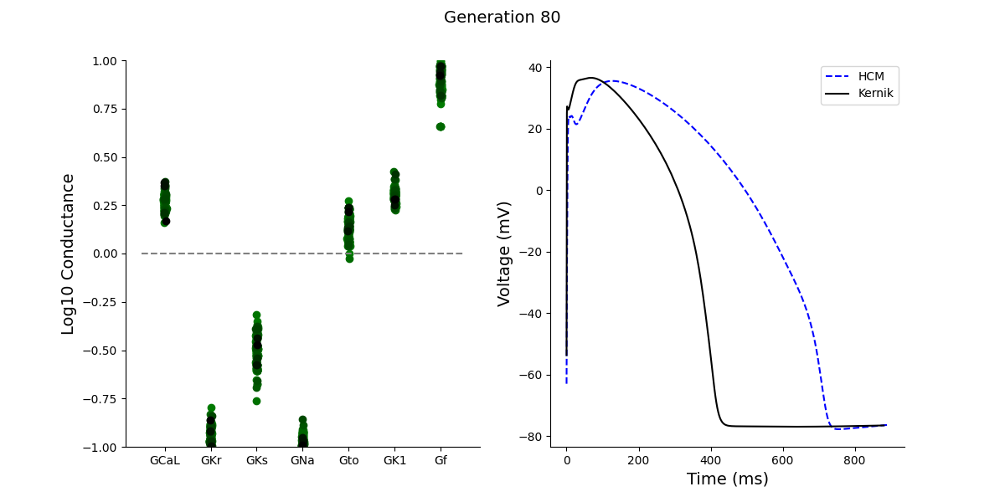
GA algorithm
feature_targets = { 'dvdt_max': [6.56, 6.84, 7.12],
'peak': [25.64, 28.26, 30.88],
'apa': [82.12, 86.24, 90.36],
'apd50': [505.11, 595.9, 686.69],
'apd90': [668.07, 711.75, 755.43],
'mdp': [-61.52, -59.62, -57.72],
}

Slide 3

Data Comparison: Currents
 | Surgical samples (Santini et al.) | GA fit | MYH7 mut (Han et al.) | ACTN2 mut (Prondzynski et al.) | MYBPC3 or TPM1 mut (Prajapati et al.) | MYL2 mut (Zhou et al.)
ICaL | Increase | Increase | Increase | Increase | Increase | Decrease
IKr | Decrease | Decrease | - | - | - | -
IKs | Decrease | Decrease | - | - | - | -
INa | Increase (INaL) | Decrease | Increase | No change | - | -
Ito | Decrease | Increase | - | - | Decrease | -
IK1 | Decrease | Increase | Increase (IK total) | - | No change | -
If | - | Increase | - | - | - | -

Slide 4
Data Comparison: APD and Ca²⁺
 | Surgical samples (Santini et al.) | MYH7 mut (Han et al.) | ACTN2 mut (Prondzynski et al.) | TnT mut (Wang et al.) | MYL2 mut (Zhou et al.)
Ca²⁺ transient | Slower | Slower | Slower | Slower | Slower
[Ca²⁺]i | Increase | Increase | - | Increase | Decrease
APD | Prolonged | Prolonged | Prolonged | Reduced | -
CaMKII | Increase | - | - | - | -
NCX | Reduced | - | - | Reduced | -

Slide 5
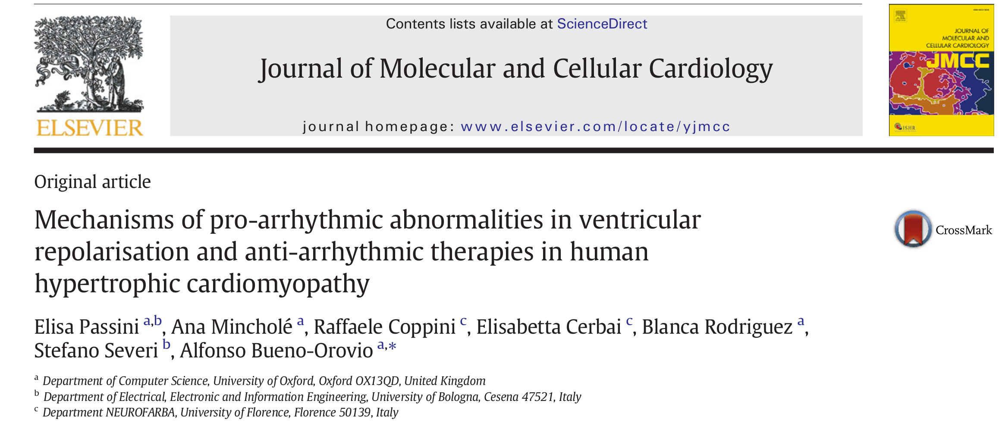

Slide 6
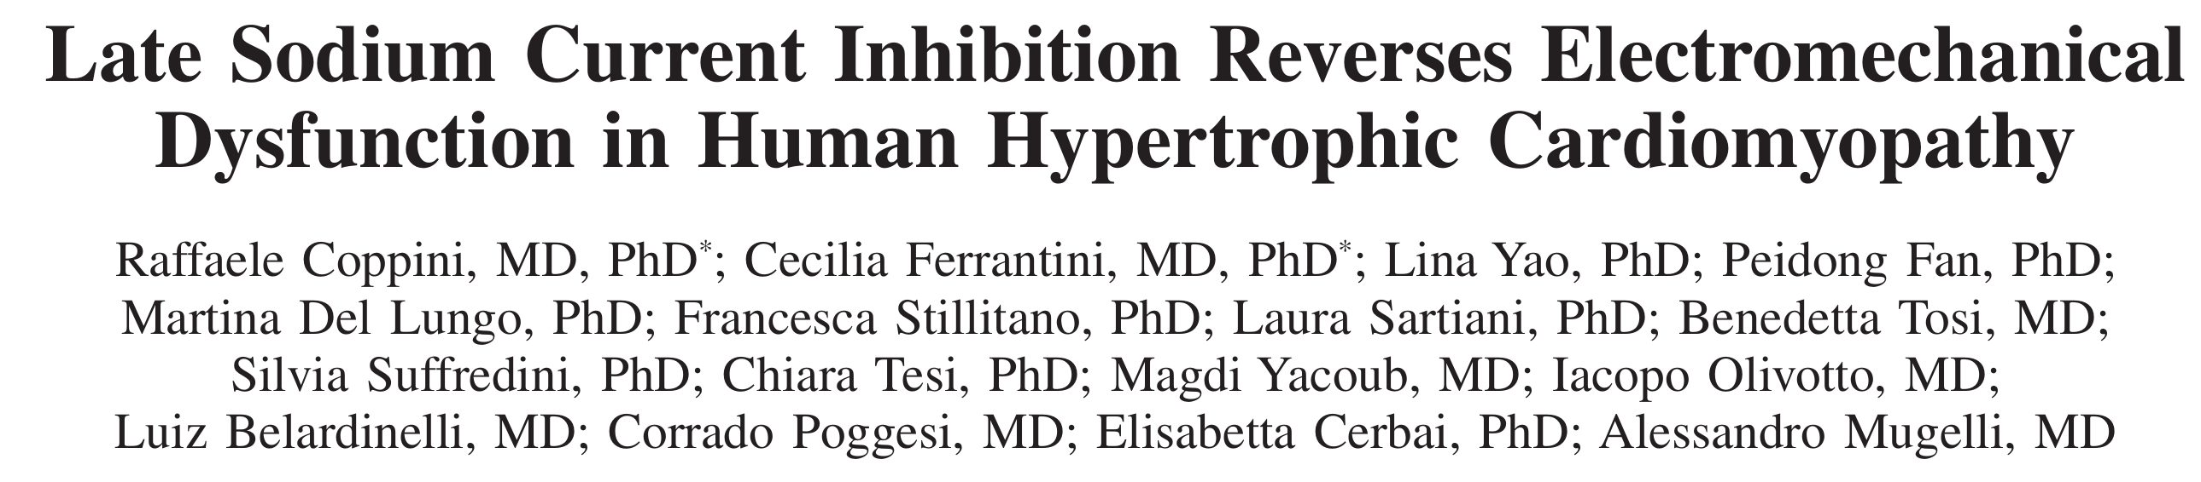
 | INaL | ICaL | Ito | IK1 | IKr | IKs
human HCM | Increase | Increase | Decrease | Decrease | Decrease | Decrease
 | APD | Ca²⁺ transient | [Ca²⁺]i | NCX | CaMKII
human HCM | Prolonged | Slower | Increase | Reduced | Increase

Slide 7
Computational Model
Model: Ord
Construction of HCM population by applying the electrical remodelling
to the CTRL population: scaling conductances
 | INaL | ICaL | Ito | IK1 | IKr | IKs | Jup | Jrel | INCX | KTRPN | INaK | INab
HCM (%) | +165 | +40 | -70 | -30 | -45 | -45 | -25 | -20 | +30 | -50 | -30 | +165
Modification of the cell radius to reproduce the +90% increase in cell volume
reported in the experiments.

